Slide 2
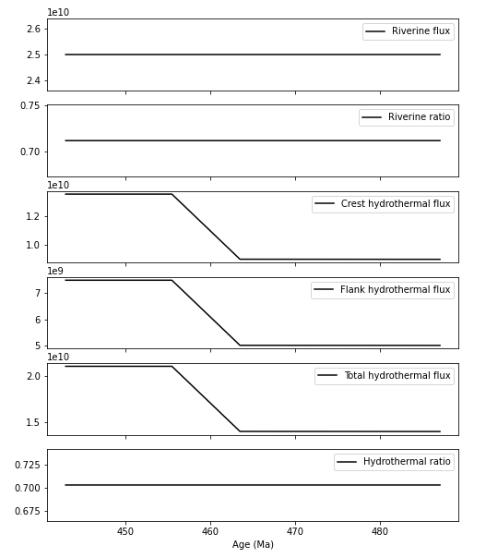
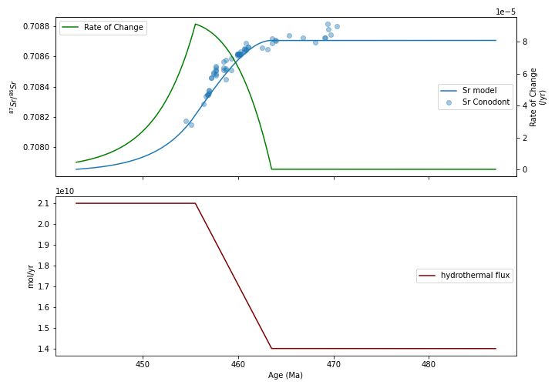
Model ver.0 (Ingram-style model)

Slide 3
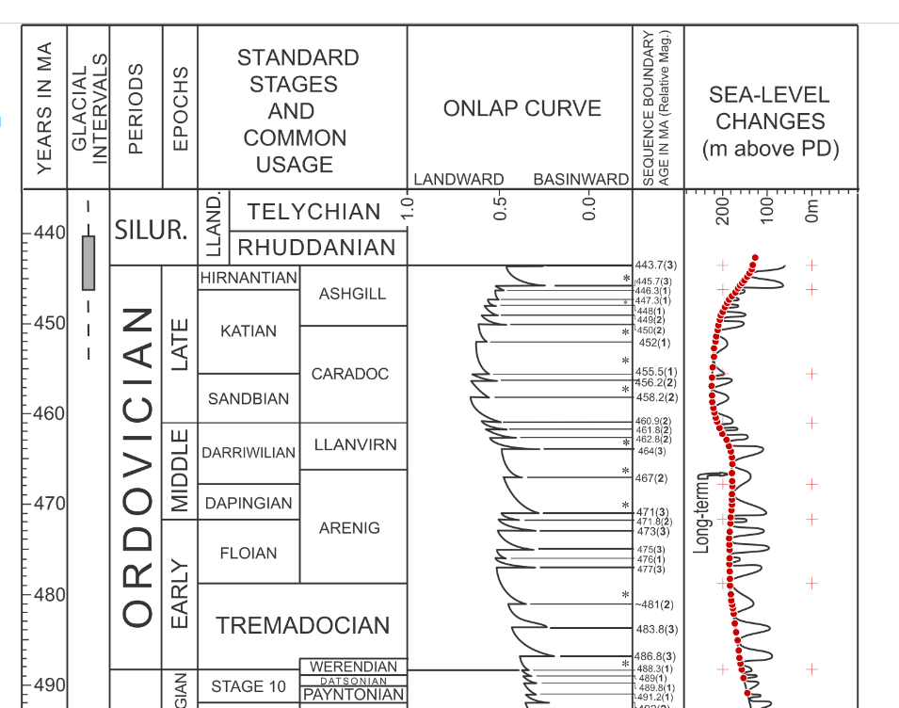
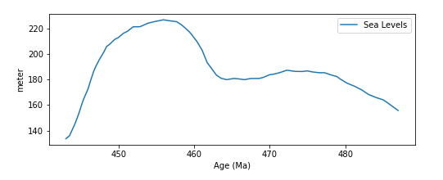
Model ver.01 (sea level curves driven model)
Hydrothermal Flux(t) = Jh0 x f(t)
where:
f(t) = sealevel(t) / mean_sealevel

Slide 4
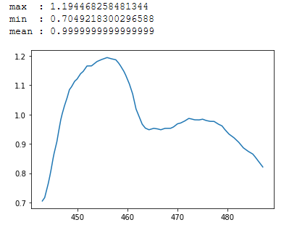
Model ver.01 (sea level curves driven model)
Hydrothermal Flux(t) = Jh0 x f(t)
where:
f(t) = sealevel(t) / mean_sealevel
f curve

Slide 5
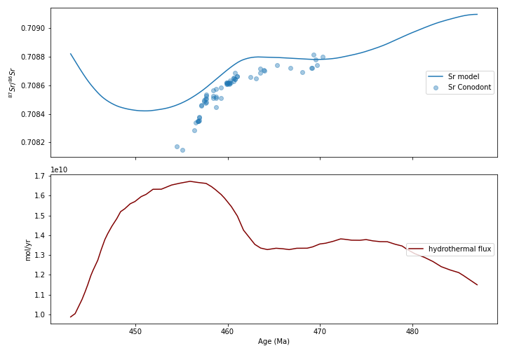
Model ver.01

Slide 6
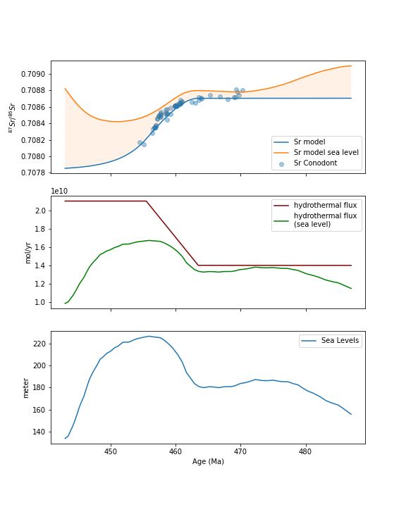
Comparison

Slide 7
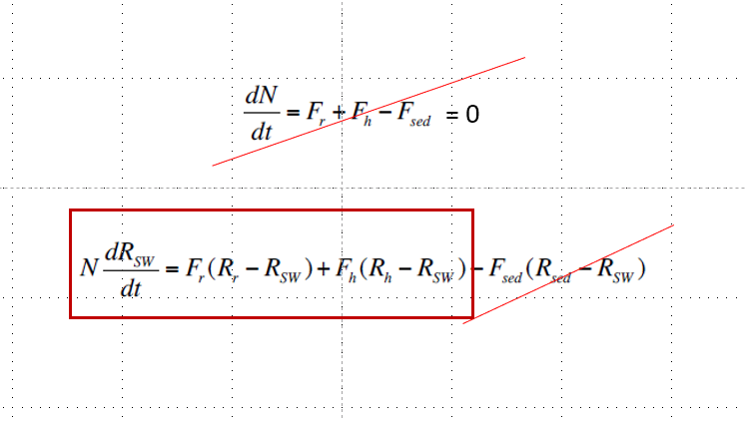
Constraining Fr and Rr
???

Slide 8
Riverine Ratio ??
Sr Isotopic Ratios of Archean and Grenvillian Rocks

Slide 9
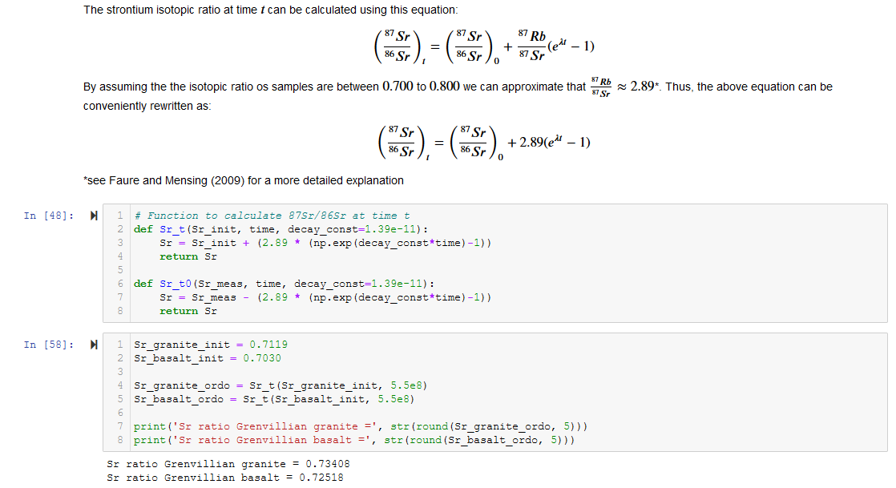
Approach #1

Slide 10
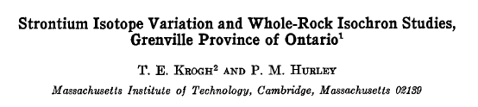
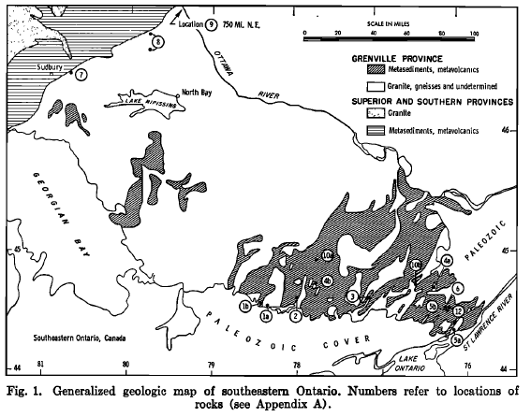
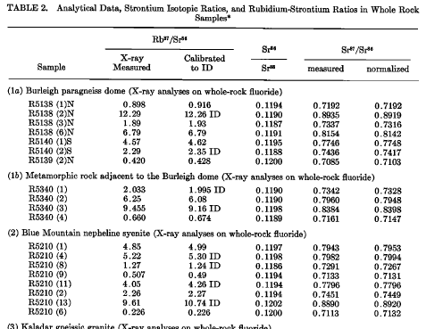
Approach #2
(Krogh and Hurley, 1968)

Slide 11
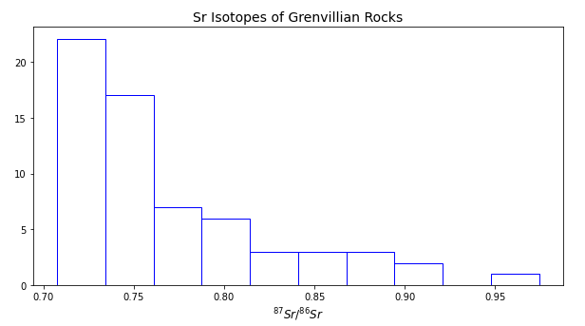
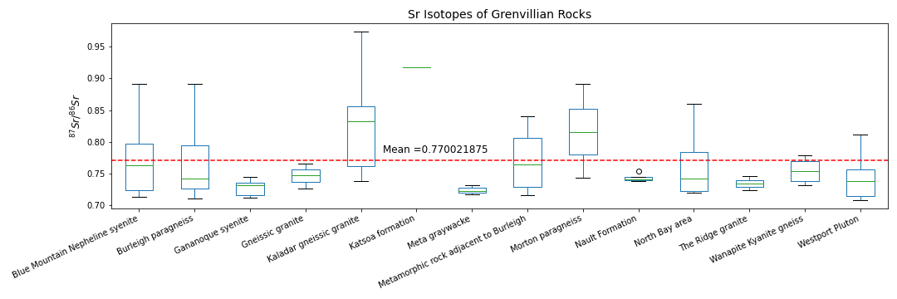
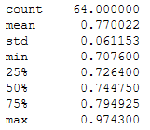
Approach #2
(Krogh and Hurley, 1968)

Slide 12
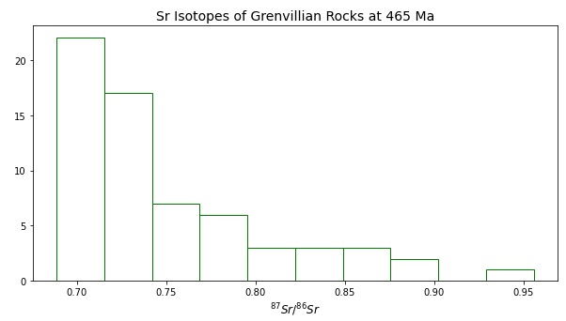
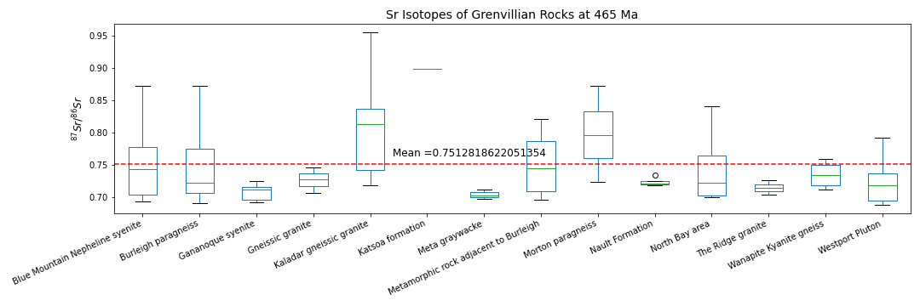
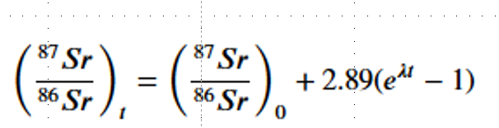
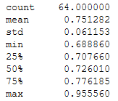
Approach #2 cont’d
(Krogh and Hurley, 1968)

Slide 13
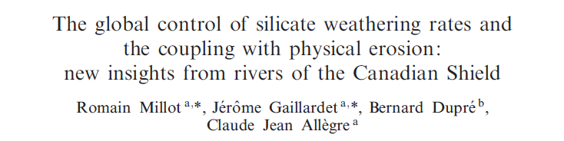
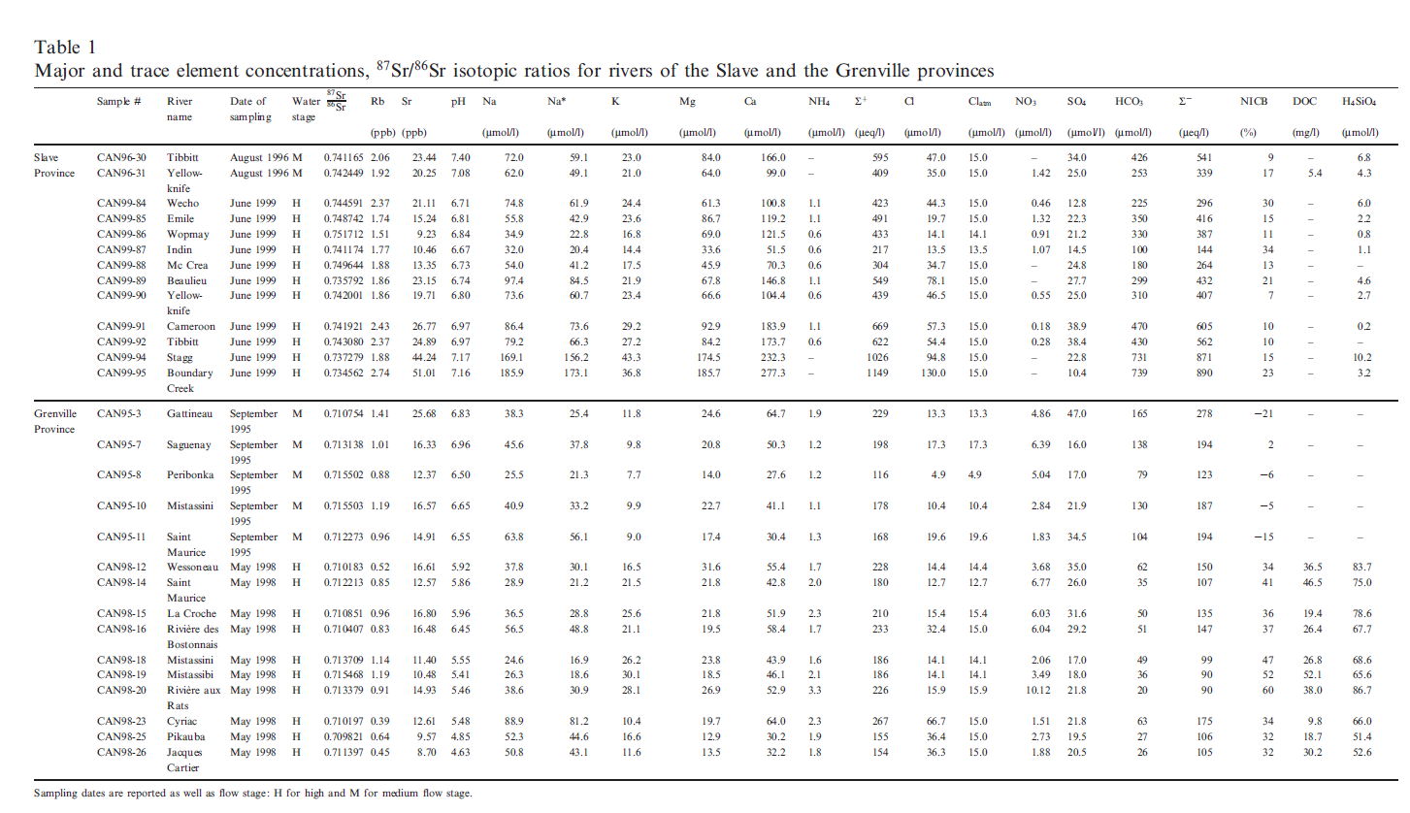
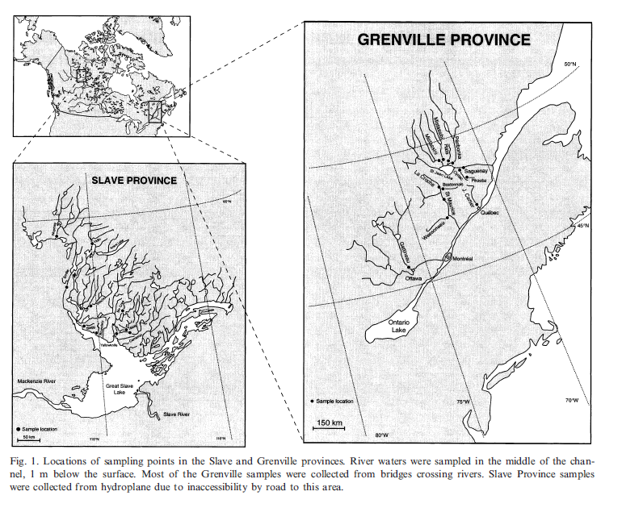
Approach #3
River Chemistry
(Millot et al., EPSL,2002)

Slide 14
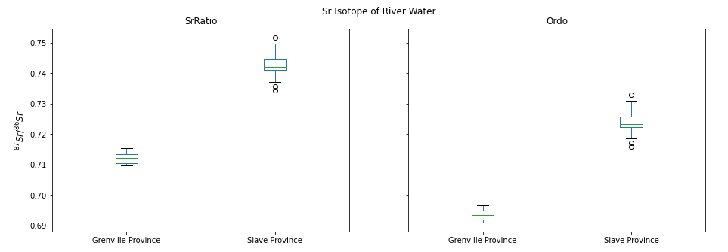
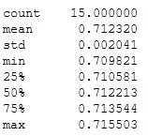
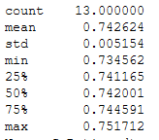
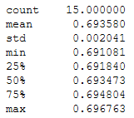
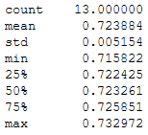
Approach #3

Slide 15
Summary
3 approaches to constrain Riverine ratios
granite – basalt mixing
metamorphic rocks
more radiogenic → Sr incorporation during metamorphism
river water
less radiogenic than expected
Riverine flux?
Laurentian source
Conwell et al model
..

